Slide 1
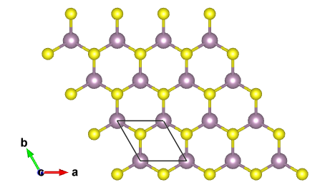
Original MoS₂
MoS₂ rotated 180°
Mo
S
Example of broken inversion symmetry in MoS₂ outlined in red.

Slide 2
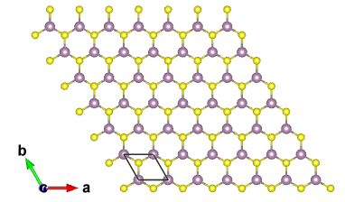
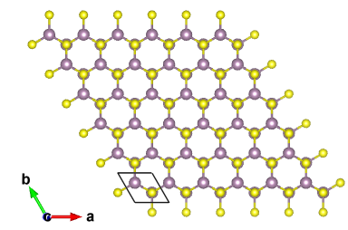

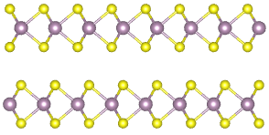

Monolayer MoS₂
Bilayer 2H MoS₂
Mo
Top view
S
Side view

Slide 3
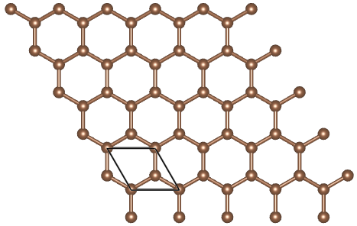
Monolayer MoS₂
Monolayer graphene
Mo
S

Slide 4
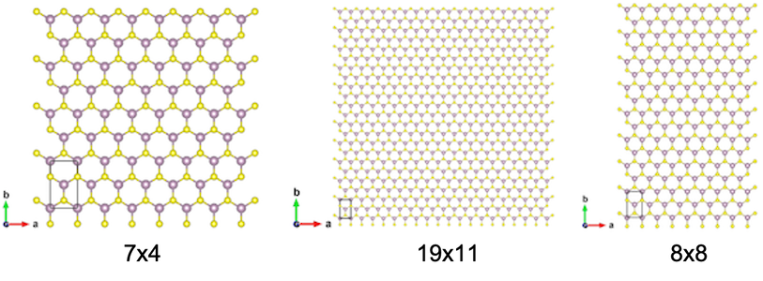

Slide 5
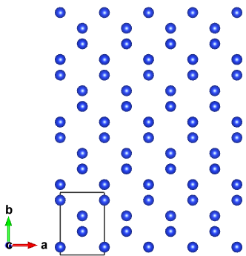
Silicon [110]
Silicon [110] CBED pattern

Slide 6
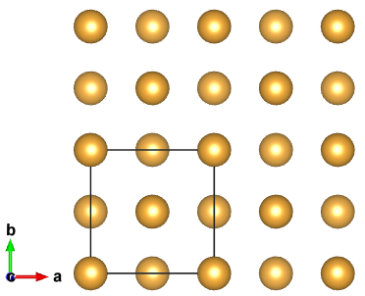
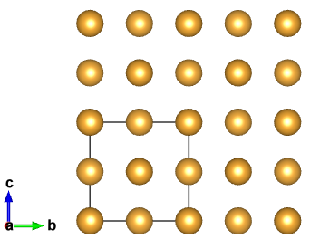
Gold: Top view
Gold: Side view
3
4
5-8
1
2
1-4

Slide 7
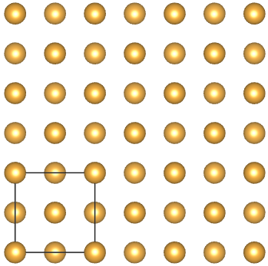
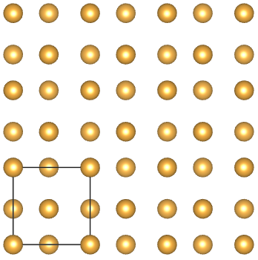
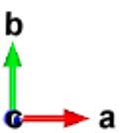
Gold: Correct unit cell
Gold: Incorrect unit cell
The left lattice has a correctly-defined unit cell. In the right lattice, the gold positions were correct, but the unit cell lengths were too large, leading to incorrect fractional positions (red arrows).

Slide 8
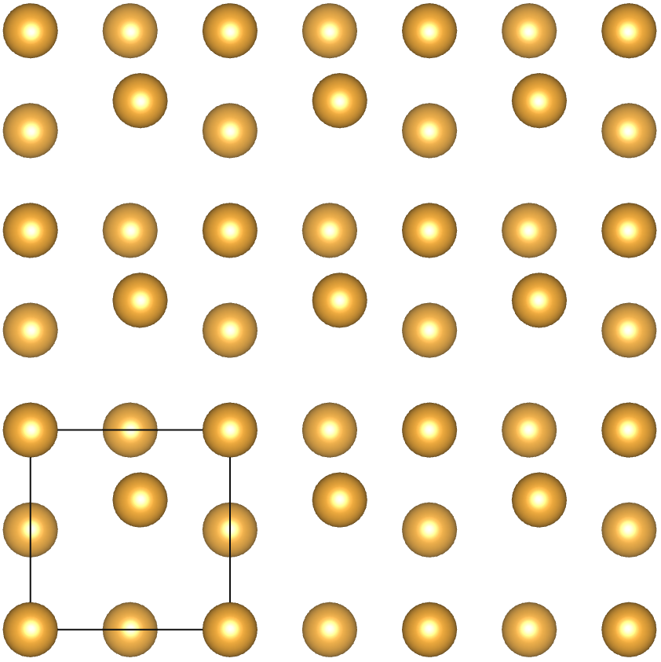
Gold: Correct unit cell
Gold: Incorrect unit cell
Gold: Incorrect unit cell
The left lattice has a correctly-defined unit cell. In the middle lattice, the gold positions were correct, but the unit cell lengths were too large, leading to incorrect fractional positions (red arrows). In the right lattice, the unit cell and three of the atomic positions are correct, but the one of the atoms had an incorrectly defined position (red circle).

Slide 9
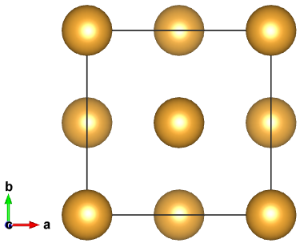
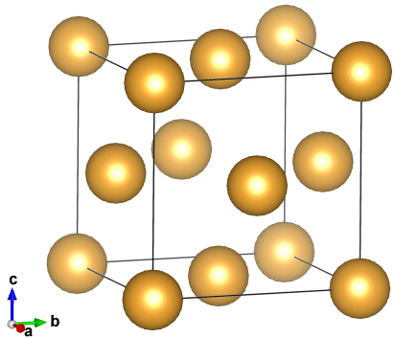
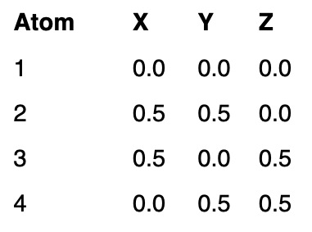
Gold: Top view
Gold: Side view
Fractional coordinates
4
3
2
1

